Slide 1
National Special Pathogen System (NSPS) Region 2
Partner Community
JANUARY 5, 2024
NY
PR
VI
NJ

Slide 2
OBJECTIVES
Discuss recent news regarding Measles and TB
Share updates regarding the mpox outbreak in the Democratic Republic of the Congo (DRC)
Review new Region 2 RESPTC Website
Overview the Region 2 Patient Transport Concept of Operations (CONOPs)
Agenda
1
Welcome & Opening Remarks
2
Recent News | Measles and TB
3
Mpox Updates and Available Resources
4
Region 2 RESPTC Website
5
Patient Transport CONOPs
6
Q&A

Slide 3
Poll Everywhere Instructions
INSTRUCTIONS TO ACCESS POLL EVERYWHERE
Option 1: QR Code Scan the QR code on your phone Enter your response Option 2: Go to the website Go to PollEv.com​/region2 Enter your response Option 3: Text Text “region2” to 22333 After you receive a confirmation, text your response to the same number
Please keep your responses to one word without spaces.
For example, instead of “Special Pathogen” submit “SpecialPathogen” without spaces.

Slide 4
Recent News | Measles and TB

Slide 5
Recent Measles Exposure
There has been an uptick of measles exposure with the increased amount of travel. The CDC has put together recommendations to limit exposure.
Travel Recommendations:
Be fully vaccinated against measles before travel, or have other evidence of measles immunity
Delay travel if sick with fever and a rash
Travel Vaccine Recommendations:
Infants aged 6–11 months: Give one dose of MMR vaccine. This dose does not count as the first dose in the routine childhood vaccination series.
People 12 months old or older, without other presumptive evidence of measles immunity: Give two appropriately spaced doses of measles-containing vaccine.
People 12 months old or older who have written documentation of one dose and no other presumptive evidence of measles immunity: Give one additional dose before travel.
Resources:
CDC: Recommendations for Airlines to Help Reduce Risk of Measles Transmission through Air Travel
CDC: Additional Measles Resources
Signs and Symptoms
High fever
Cough
Runny nose
Red, watery eyes
Rash appearing 3–5 days after initial symptom
Source: CDC

Slide 6
Recent Measles Exposure
There has been an uptick of measles exposure with the increased amount of travel. The CDC has put together recommendations to limit exposure.
Prevent healthcare-associated measles exposures
Measles is one of the most contagious infections and can remain airborne for up to two hours
Screen for rash with fever at the point of entry of a healthcare facility
Inquire about recent international travel or known exposure to measles
Immediately institute airborne precautions for patients with suspected measles
Report suspected measles and collect specimens:
Report suspected cases immediately to the NYC Department of Health’s Provider Access Line (866-692-3641) at time of initial clinical suspicion
Do not wait for laboratory confirmation to report
Collect specimens for testing at the NYC Department of Health’s lab
Nasopharyngeal or oropharyngeal swab for PCR
Serology for IgM/IgG testing
Treatment of individuals with measles
Medical care of cases is supportive
Vitamin A may be given to children hospitalized for measles
*Slide added after the meeting for additional context

Slide 7
Recent Measles Exposure
There has been an uptick of measles exposure with the increased amount of travel. The CDC has put together recommendations to limit exposure.
Post-exposure prophylaxis (PEP) for individuals exposed to measles
Need for PEP depends on measles immunity status (e.g. documented vaccination, IgG titers), age, pregnancy status, immunocompromising conditions, and # days since exposure
MMR vaccine prophylaxis <3 days of initial exposure
Non-immune individuals aged >6 months (without vaccine contraindications)
Intramuscular immune gloubulin (IGIM) <6 days of initial exposure
Aged <1 year
Pregnant and not immune to measles
Severely immunocompromised
Non-immune pregnant individuals
Resources:
Treatment, PEP, vaccination recommendations: www.nyc.gov/health/measles
See guidance for providers
Screening and isolation guidance: www.nyc.gov/health
Search “communicable disease preparedness”
*Slide added after the meeting for additional context

Slide 8
Tuberculosis (TB) in New York City
Since spring 2022, >150,000 people have come to NYC shortly after crossing the U.S.-Mexico border. Many lived in or traveled through countries with high TB rates.
Considerations:
TB is a treatable but potentially severe disease
TB affects people of all ages, races and backgrounds
Screen people who recently arrived in NYC from countries with high TB rates for:
Symptoms of active TB
Latent TB infection
Testing, treatment, and consultation options are available
Health Department Chest Centers provide the following at no cost to patients:
Active and latent TB treatment
TB testing and evaluation (for people with a known exposure or who recently arrived from countries with high TB rates)
Resources:
CDC: Resources for TB Programs
Tuberculosis - NYC Health
Signs and Symptoms of Active TB
Cough for >2 weeks
Unexplained weight loss
Loss of appetite
Night sweats
Fever
Hemoptysis (coughing up blood)
Source: CDC, NYC DOHMH Dear Colleague letter, April 11, 2023

Slide 9
Mpox Update and Resources

Slide 10
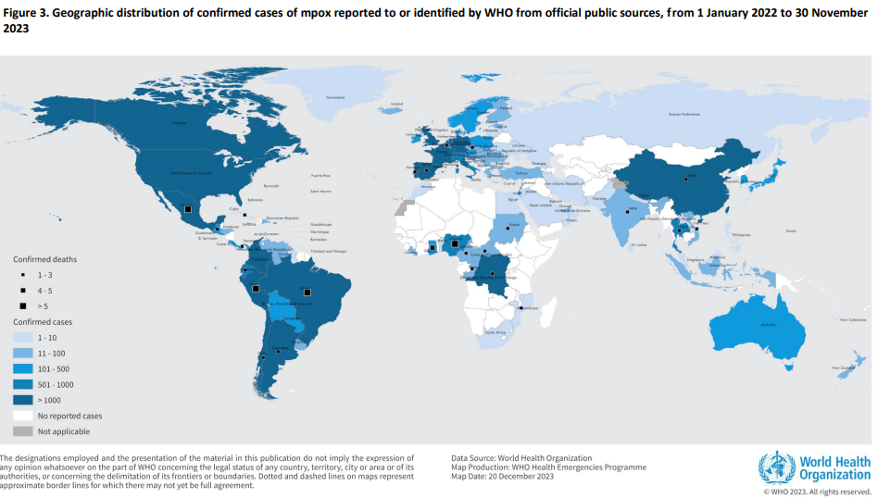
Democratic Republic of the Congo (DRC) Mpox Outbreak
Since January 2023, there have been a total of 12,000+ suspected mpox cases in the DRC with a case fatality rate of 4.6%
Mpox Virus (MPXV) has two known clades
The current outbreak in the DRC is Clade I (formerly known as the Congo Basin or Central African clade)
The 2022 global outbreak was Clade II (formerly known as the West African clade)
Clade I MPXV is known to be more severe, with:
Higher transmission rates
Increased virulence
Greater potential for complications
Clade 1 MPXV waste is classified as Category A infectious substance

Slide 11
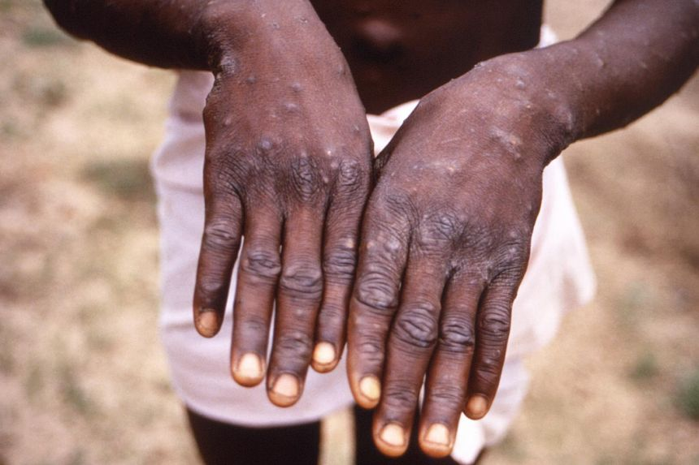
Mpox Symptoms and Clinical Presentation
Mpox initially presents with flu-like symptoms
Symptoms and Clinical Presentation:
Fever/chills, headache, muscle aches backache, exhaustion, and swollen lymph nodes.
Rash or lesions may appear 1-4 days after initial symptoms as pimples or blisters on the face, inside mouth, hands, feet, chest, genitals, or anus.
Atypical presentation has been reported:
Rash beginning in mucosal, genital or perianal areas
Lesions may be localized to specific body site
Symptoms such as anorectal pain, tenesmus, and rectal bleeding
Rash presentation similar to varicella or some STIs, such as syphilis, herpes, or other etiologies of proctitis

Slide 12
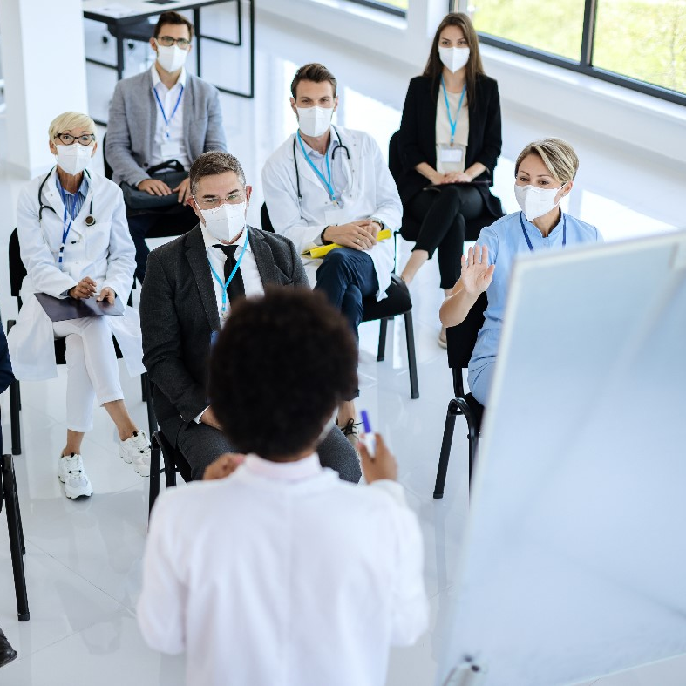
Trivia #1
Which of the following is NOT a typical symptom of Clade I mpox?
Fever/Chills
Rash or lesions
Diarrhea
Exhaustion
Scan to answer

Slide 13
CDC and NETEC Guidance
The following guidance from the CDC and NETEC can support facilities
CDC Guidance (as of December 7th)
Alert state/jurisdictional departments of health
Submit lesion specimens for testing
Mpox Category A waste management guidance
Vaccines and Medical Countermeasures
Vaccines (e.g., JYNNEOS) and medical countermeasures (e.g., tecovirimat, brincidofovir, and vaccinia globulin intravenous) are available and are expected to be effective for both clades
Proactive Outreach
Proactive outreach to at-risk communities is recommended

Slide 14
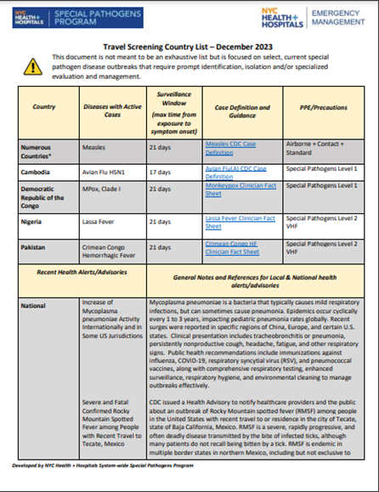
Additional Resources
Resources can help facilities monitor and care for patients under investigation
NETEC Resources
NETEC offers free consultations, technical support services, and online resources
Bellevue Special Pathogen Program Travel Screening List
The travel screening list is published monthly on www.r2resptc.org
Facilities can use this resource to support prompt identification, isolation and/or specialized evaluation and management
Joint Commission Requirements (IC.07.01.01)
The Joint Commission offers hospital infection prevention and control requirements to support preparedness for high-consequence infectious diseases or special pathogens

Slide 15
Mpox 2023 – CDC and Region 2 DOH Health Advisories
Multiple Region 2 Departments of Health (DOH) (New York, New Jersey, and U.S. Virgin Islands) issued a health advisories alerting clinicians to a recent increase in mpox cases in late 2023.
“
Mpox illnesses, including severe infections, continue to occur across the United States. CDC recommends people with the sexual risk factors for mpox get vaccinated now if they have not already received two doses of JYNNEOS vaccine. Those at risk include (but are not limited to) men who have sex with men (MSM) who have more than one sexual partner and those who have sex with them, regardless of gender. CDC does not currently recommend more than two vaccine doses.
”
Source: U.S. Virgin Islands Department of Health
Region 2 Department of Health Resources:
New York DOH Health Advisory, New Jersey DOH Health Advisory
Puerto Rico DOH Mpox Resources, U.S. Virgin Islands DOH Health Advisory

Slide 16
Trivia #2
When do mpox rash or lesions typically appear after symptom onset (e.g. flu-like symptoms)?
1-4 days
5-7 days
8-10 days
11-15 days
Scan to answer

Slide 17
The Region 2 RESPTC Website
www.r2resptc.org

Slide 18
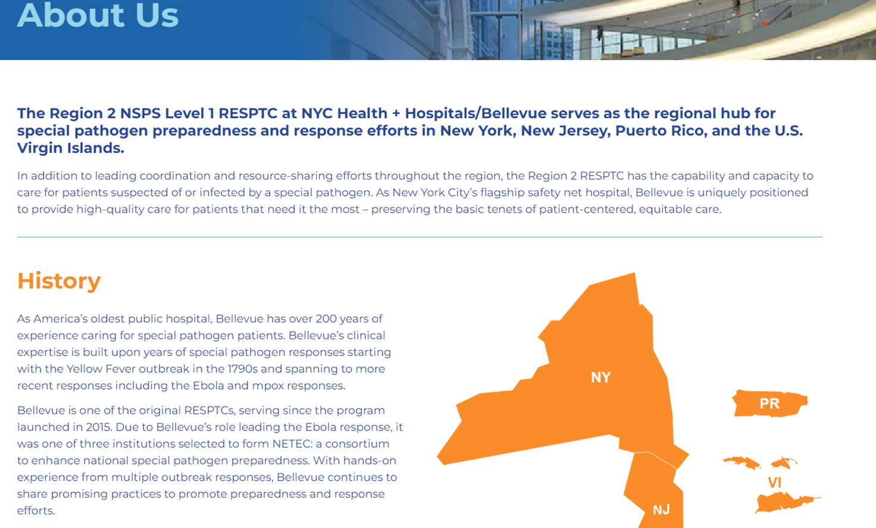
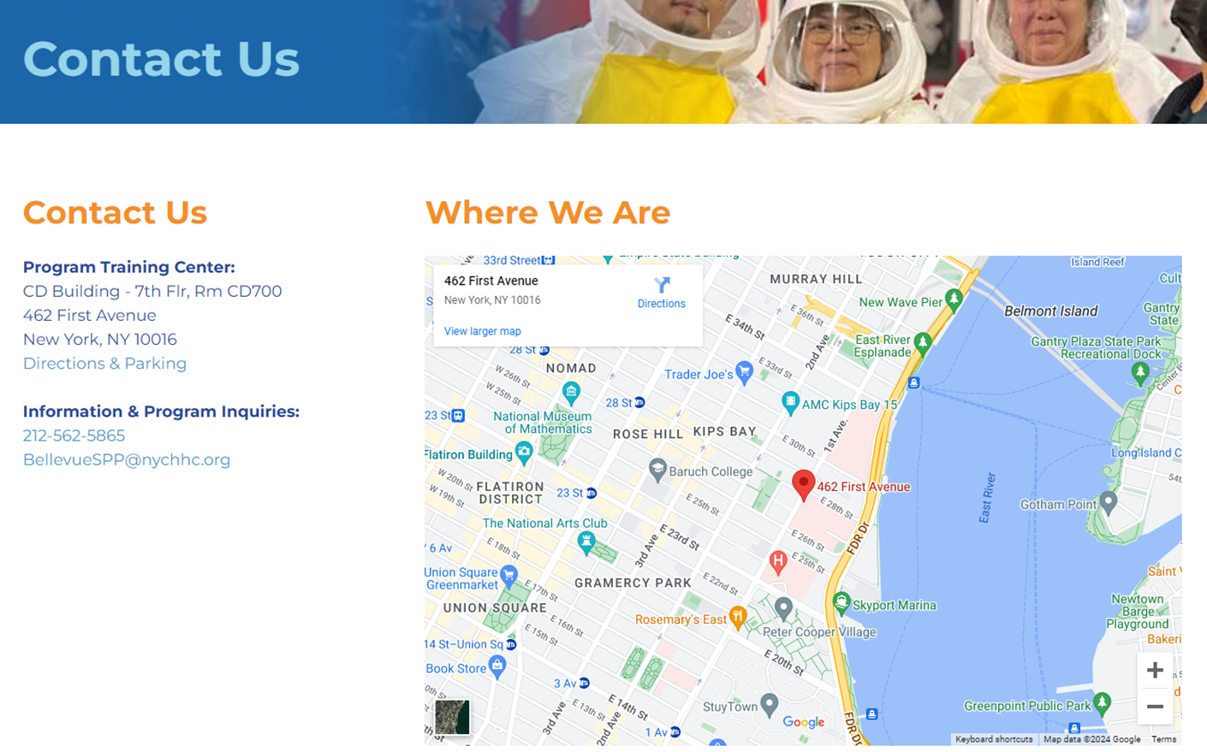
Region 2 RESPTC Website
The website officially launched in November 2023! Below highlights key resources available on the website.
RESPTC About Us
Learn about the Region 2 RESPTC on the About Us pages
This includes Region 2’s background and history, the team, and about the NSPS
Contact Us
Contact information including the Program Training Center and Information Inquiries can be found on the Contact Us page

Slide 19
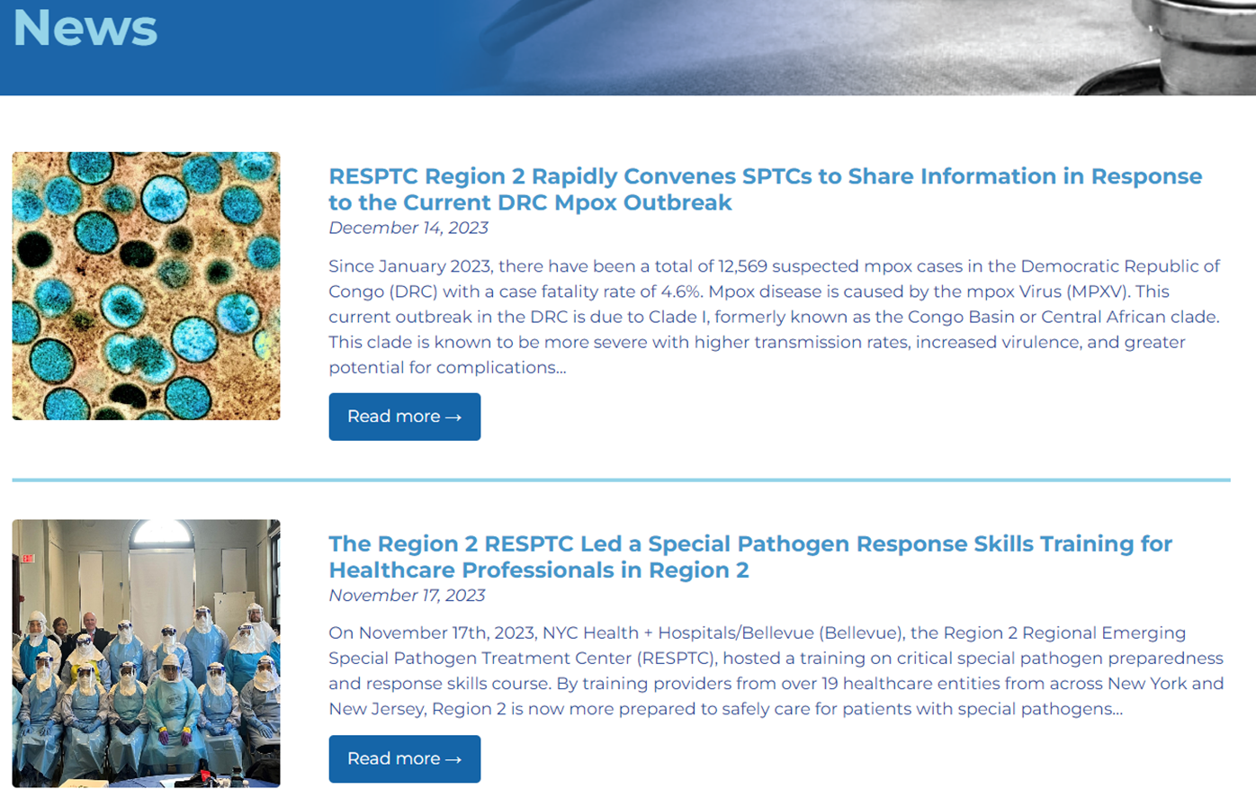
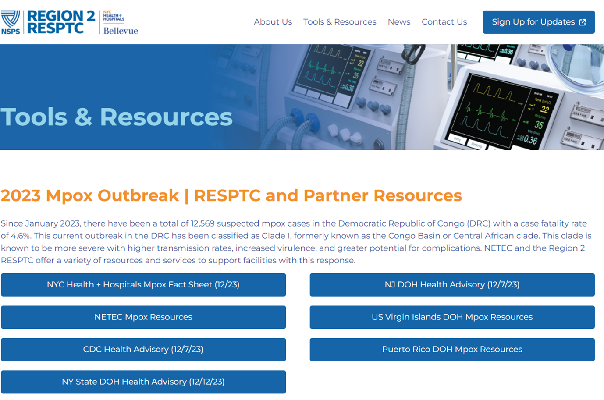
Region 2 RESPTC Website Part 2
The website officially launched in November 2023! Thank you to Bellevue’s Digital Solutions Team for all the support! Below highlights key resources available on the website.
RESPTC Tools and Resources
R2 RESPTC offers free tools and resources that are continually updated on the Tools & Resources page, including:
NYC Health + Hospital’s monthly travel screening list to support prompt identification, isolation and/or specialized evaluation and management
Partner resource highlights, such as relevant NETEC materials
News
Regular news stories are published on the News page

Slide 20
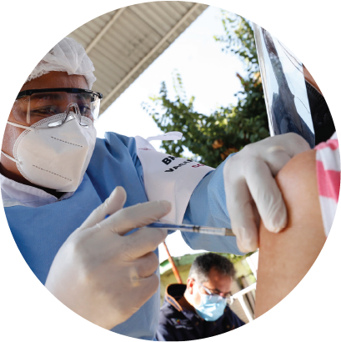
Trivia #3
Where can you find the updated travel screening list?
Under “News”
Under “Tools & Resources”
Under “About the Region 2 RESPTC”
Under “About the NSPS”
Scan to answer

Slide 21
Question #4
Scan to answer
What would you like to see on the R2 RESPTC website?

Slide 22
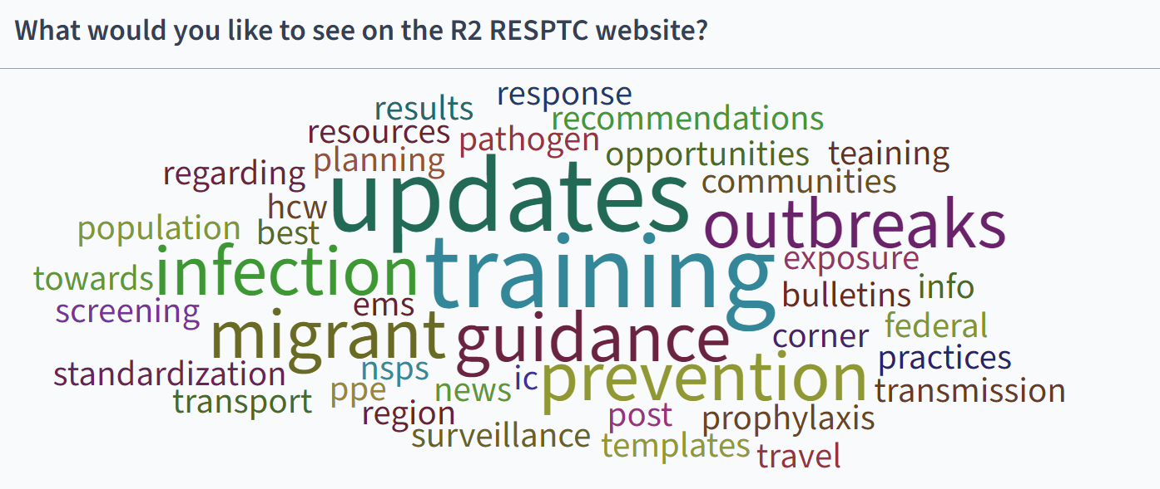
Question #4 - Result

Slide 23
The Region 2 RESPTC Website Live Demo

Slide 24
HHS Region 2 High-Consequence Infectious Disease Patient Transport Concept of Operations

Slide 25
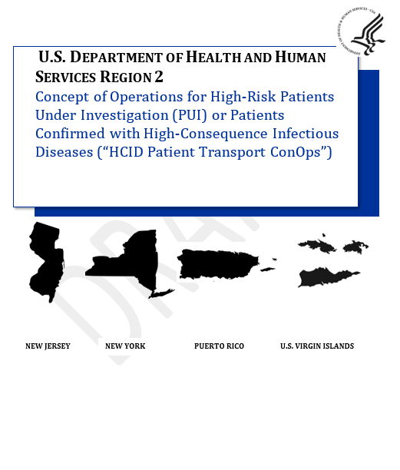
The Region 2 HCID Patient Transport Concept of Operations (CONOPs)
The Region 2 RESPTC is in the process of updating the CONOPs and will share the final document with partners in the coming months
A Concept of Operations (CONOPs) “presents a clear picture of the sequence and scope
of the planned emergency response, what should happen, when, and at whose direction” (FEMA)
The HHS Region 2 Concept of Operations for High-Risk Patients Under Investigation (PUI) and Patients Confirmed with High-Consequence Infectious Diseases (“HCID Patient Transport ConOps”)
Outlines an HHS Region 2 concept of operations for safely transporting a HCID patient to NYC Health + Hospitals/Bellevue, the Region 2 RESPTC, or another equipped facility
Details cross-jurisdictional considerations and is intended to supplement jurisdiction-specific plans

Slide 26
The Patient Journey to Bellevue
This graphic illustrates an HCID patient transport to Bellevue to summarize the document. Please note it does not include other transport scenarios
INITIAL NOTIFICATION
ARRANGING TRANSPORT
FINAL TRANSFER
GROUND TRANSPORT
Patient presents symptoms
A patient presents at a facility as a high-risk PUI of a high-consequence infectious disease. If applicable, samples are sent to the lab.
IS THE PATIENT IN NEW YORK CITY OR AT ONE OF THE FOLLOWING FACILITIES?*
Robert Wood Johnson University Hospital
Northwell Health | Glen Cove Hospital
Stony Brook University Hospital
YES
FDNY transports patient
FDNY transports from the facility to Bellevue.
YES
Facility requests transfer
The facility’s capacity or capability is exceeded.
The facility coordinates with their department of health (DOH) to request a transfer to Bellevue.
IS THE PATIENT WITHIN A TWO HOUR DRIVE?
NO
Partners identify EMS agency
The facility coordinates with their DOH, Bellevue, and NYC DOHMH to identify an appropriate EMS agency.
EMS agency transports patient
The EMS agency transports from the facility to Bellevue.
NO
AIR TRANSPORT
Partners identify EMS agency
The facility coordinates with their DOH to identify an appropriate EMS agency to transport the patient to the airport.
EMS agency and PAG transport patient
The local EMS agency transports the patient to the airport and PAG transports the patient to NYC.
Partners approve transfer
NYCDOHMH and Bellevue approve the transfer request. A clinical call coordinates relevant parties to arrange details and ensure the transfer is appropriate.
Partners request aircraft
The sending DOH works with the ASPR REC to request Phoenix Air Group (PAG) aircraft to transport to NYC.
FDNY transports patient
FDNY transports the patient from the airport to Bellevue.
*List of facilities eligible for FDNY transport as of October 2023.

Slide 27
Q&A

